Slide 1
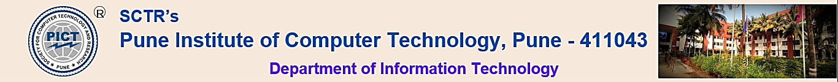
Project Review-II
Youth YANA ( You Are Not Alone ): Mental Health Consulting WebApp
Group Id: 41
Group Members:
Sumit Kawale 43323
Harshvardhan Patil 43346
Onkar Swami 43374
Tanmay Bonde 43375
Name of Guide: Mrs. Kirti Digholkar
Name of Reviewers:
Mr.Sachin Selkhe
Mrs.Prajakata Shinde
Domain: AIML + MERB

Slide 2
INTRODUCTION
PROBLEM STATEMENT
ABSTRACT
USER AND SYSTEM REQUIREMENTS
FUNCTIONAL AND NON-FUNCTIONAL REQUIREMENTS
BLOCK DIAGRAM
DATA FLOW DIAGRAM
ALGORITHMS AND MODELS
REFERENCES

Slide 3
Introduction
College students' mental health is crucial for self-discovery, education, and personal growth, requiring empathy and understanding. Machine learning applications can detect mental health problems, but ethical guidelines are essential. A psychological data management system and AI calculations can help prevent crises. A web-based self-screening program can help identify and seek help for students who may not seek treatment.

Slide 4
Problem Statement
The primary problem we aim to address is the limited accessibility and confidentiality issues surrounding mental health counseling for college students.
Key aspects of the problem include:
Limited Resources: Universities often have a shortage of mental health professionals, leading to long wait times for appointments.
Stigma: There is a stigma surrounding mental health, preventing many students from seeking help.
Confidentiality: Students may be hesitant to share their thoughts and feelings with human counselors due to concerns about privacy and judgment.
Accessibility: Some students may not have access to counseling services due to geographical constraints or other logistical barriers.

Slide 5
Abstract
Youth YANA is proposing a web-based mental health consulting system for college students, focusing on privacy, security, and technology. The system includes a self-screening and referral system, mobile device-based mental health analysis, and a mobile app for assessing mental health applications. The system uses an ML model to detect mental health issues early and provide necessary steps to overcome them, highlighting the importance of privacy and security in the digital era.

Slide 6
User Requirements
Abstract
Privacy and Security
Accessibility and User-Friendliness
Support and Assistance
Comprehensive feature:
Mental health assessments
Evidence-based interventions
Progress tracking
Support groups

Slide 7
System Requirements
Operating system: The webapp should be compatible with the major operating systems, such as Windows, macOS, and Linux.
Web browser: The webapp should be compatible with the major web browsers, such as Chrome, Firefox, and Safari.
Internet connection: The webapp requires a reliable internet connection to access its features and functionality.
Hardware: The webapp should be able to run on a variety of hardware devices, including desktop computers, laptops, tablets, and smartphones. However, the specific hardware requirements will vary depending on the features and functionality of the app.

Slide 8
Functional Requirements
User-Friendly Interface and Chat Support
User Registration and Profile Management
In-App Counseling
Medication and Pharmacy Integration
Emergency Support and Personal Counselor
User Feedback and Ratings

Slide 9
Non-Functional Requirements
Non-Functional Requirements:
Security: Implement secure user authentication and authorization mechanisms.
Performance: Maintain low response times to provide a smooth user experience. Ensure the chatbot can handle peak loads during high-traffic periods.
Reliability: The chatbot should be available 24/7 with minimal downtime.
Scalability: Design the system to scale horizontally and vertically to accommodate growing user numbers.
Cross-Platform Compatibility: Ensure the chatbot works seamlessly on various devices and platforms, including web, mobile, and messaging apps.

Slide 10
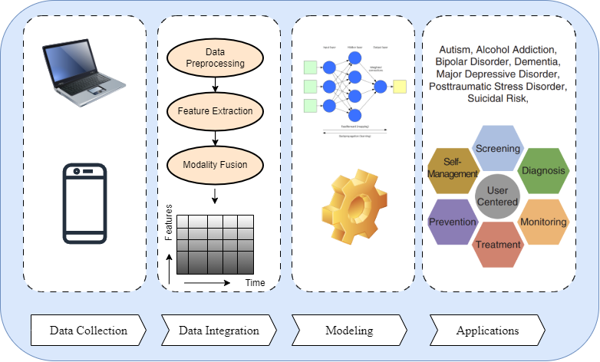
BLOCK DIAGRAM

Slide 11
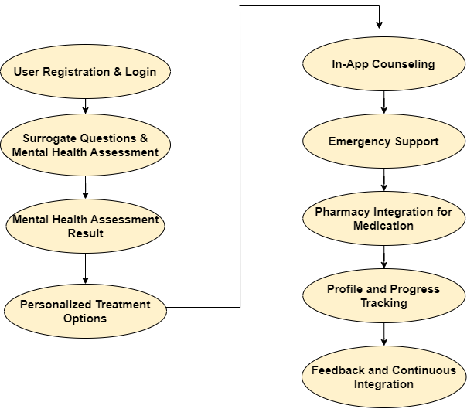
DATA FLOW DIAGRAM

Slide 12
ALGORITHM AND MODELS
AODEsr
Multilayer Perceptron
RBF Network
IB1
KStar
Multiclass Classifier
FT
LAD Tree

Slide 13
REFERENCES
[1] Rohizah Abd Rahman, Khairuddin Omar, Shahrul Azman Mohd Noah, Mohd Shahrul Nizam Mohd Danuri, and Mohammed Ali Al-Garadi. Application of machine learning methods in mental health detection: a
systematic review. Ieee Access, 8:183952–183964, 2020.
[2] Dennis Becker. E-mental health: Contributions, challenges, and research opportunities from a computer science perspective. In Encyclopedia of E-Health and Telemedicine, pages 928–936. IGI Global, 2016.
[3] Christopher Burr, Jessica Morley, Mariarosaria Taddeo, and Luciano Floridi. Digital psychiatry: Risks and opportunities for public health and wellbeing. IEEE Transactions on Technology and Society, 1(1):21– 33, 2020.
[4] Yan Ding, Xuemei Chen, Qiming Fu, and Shan Zhong. A depression recognition method for college students using deep integrated support vector algorithm. IEEE access, 8:75616–75629, 2020.
[5] Jing Han, Zixing Zhang, Cecilia Mascolo, Elisabeth Andre, Jianhua ́ Tao, Ziping Zhao, and Bjorn W Schuller. Deep learning for mobile ̈ mental health: Challenges and recent advances. IEEE Signal Processing Magazine, 38(6):96–105, 2021………..

